Slide 1
Detection of Diabetic Retinopathy using Deep Learning
Team Members :
Gonuguntla Venkata Sai Goutham
A20450688

Slide 2
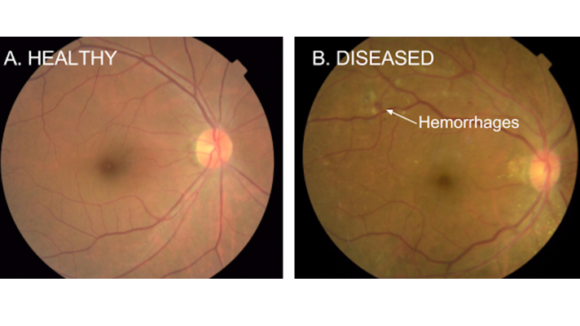
What is Diabetic Retinopathy?
Diabetic retinopathy is a serious sight-threatening complication of diabetes.
Diabetic retinopathy (DR) is one of the most important causes of visual loss worldwide and is the principal cause of impaired vision in patients between 25 and 74 years of age.
The vast majority of patients who develop DR have no symptoms until the very late stages

Slide 3
Problem Statement
The leading cause of blindness is diabetic retinopathy, millions of people are affected by this disease. One out of two people having diabetics suffer from diabetic retinopathy.
Currently, in India technicians capture the images and rely on the highly-trained doctors to diagnose diabetic retinopathy by studying the fundus images whereas manually checking the fundus images is time consuming and costly.
It takes lots of knowledge and effort for a human to diagnose retinopathy in early stages
Proposed Solution
In order to overcome above problem we can implement convolutional neural network a deep learning algorithm which can take image as input and classify the severity of disease.
In this process, Kaggle has created a competition Asia Pacific Tele-Ophthalmology Society (APTOS) sponsored blindness detection, California Health Care Foundation [CHCF] sponsored Diabetic Retinopathy Detection competition by providing around 3662 scans of eye fundus to train and test the model.

Slide 4
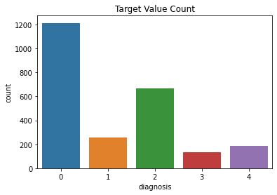
Data:
Kaggle dataset is used which is of 9.52GB in size and contains 3662 train and test fundus images.
There are 5 target labels ranging from 0 to 4 which tells the severity of diabetic retinopathy by seeing the fundus images.
These numerical labels are encoded as categories which are given below:
{0 : 'No DR',
1 : 'Mild',
2 : 'Moderate',
3 : 'Severe',
4 : 'Proliferative DR'}

Slide 5
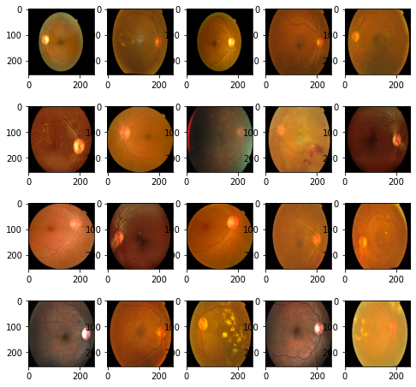
Preprocessing:
I have applied stratified data sampling method and splits are defined as below
2453 images for training
1209 images for validation
1928 images for test
Below image represents a sample of training dataset using ImageDataGenerator

Slide 6
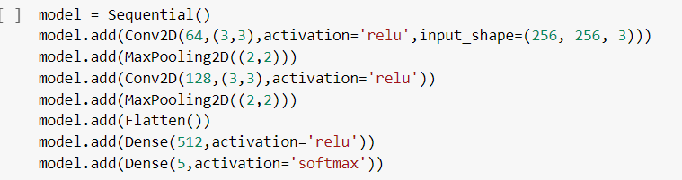
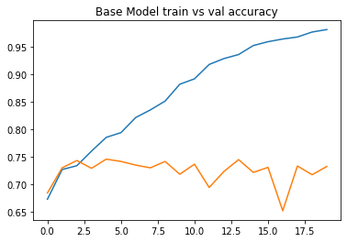
Model Building
Model-1:
Model architecture: The architecture consists of couple of convolutional layers, max pooling before a fully connected dense layer
Model Performance

Slide 7
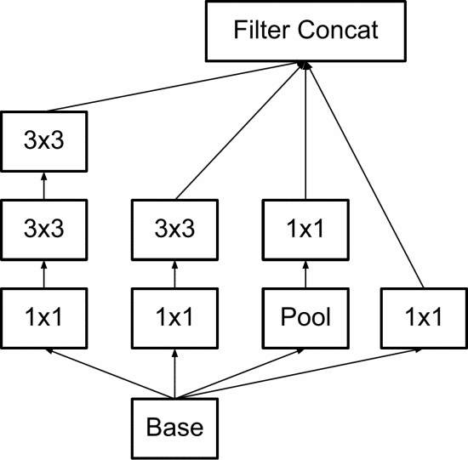
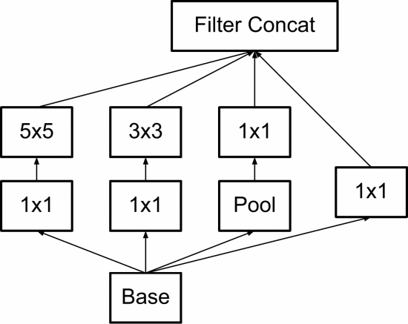
Model 2
Inception Architecture:
Figure:1(a):Naive
Figure:1(b):Modified

Slide 8
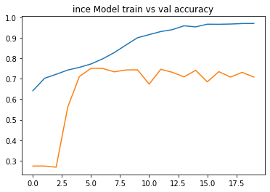
Model-2 Performance
Train vs valid Accuracy

Slide 9
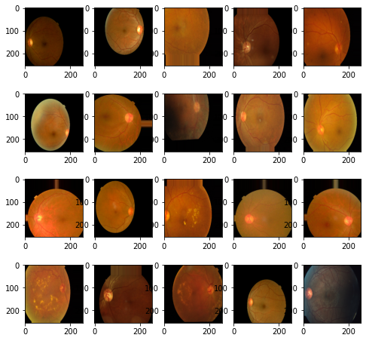
Model 3: Inception V3 with
Data Augmentation: I have applied width shift, height shift and horizontal flip on each of images and after the augmentations the images are shown below
Before Augmentation
After Augmentation

Slide 10
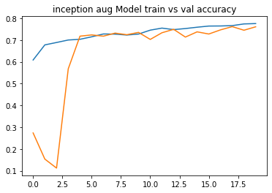
Model-3 Performance:
Train vs valid Accuracy

Slide 11
Results:
Model | Accuracy
Base Model | 70%
Custom Inception v3 | 75%
Custom inception v3 – data augmented | 80%

Slide 12
References:
Detecting Diabetic Retinopathy using Deep Learning by Yashal Shakti Kanungo, Bhargav Srinivasan, Dr. Savita Choudhary.
Rethinking the Inception Architecture for Computer Vision by Christian Szeged, Vincent Vanhoucke, Sergey Ioffe, Jon Shlens, Zbigniew Wojna.

Slide 13
Thank You

